Slide 1
Advanced Matchlib Topics 2021
Stuart Swan | Platform Architect
Siemens EDA, a part of Siemens Digital Industries Software

Slide 2
Catapult SystemC / Matchlib Resources
This presentation assumes you have reviewed the slides and examples below:
Matchlib training slides
$MGC_HOME/shared/examples/matchlib/toolkit/doc/matchlib_customer_training.ppt
Matchlib example kit in Catapult install
$MGC_HOME/shared/examples/matchlib/toolkit

Slide 3
Brief Review of Matchlib Interfaces
Message Passing Interfaces : Push/Pop, PushNB/PopNB
$MGC_HOME/shared/examples/matchlib/toolkit/examples/05_push_pop
Data + Valid Protocol :
…toolkit/examples/15_data_valid_protocol
Event Pulse :
…toolkit/examples/94_event_pulse
Process Sync:
…toolkit/examples/12_ping_pong_mem
External Dual Port RAM:
…toolkit/examples/12_ping_pong_mem
ARM AXI4:
…toolkit/examples/08_dma
ARM APB:
…toolkit/examples/52_apb

Slide 4
Brief Review of Matchlib Interfaces (continued)
Native SystemC signals :
…toolkit/examples/04_ready_valid
Toggle Protocol :
…toolkit/examples/13_toggle_protocol
FIFO instantiation between modules :
…toolkit/examples/10_fifo_channel_hier
FIFO instantiation between processes within a module :
…toolkit/examples/11_fifo_channel_flat

Slide 5
Brief Review of Primary Matchlib Features
Throughput accurate modeling in Pre-HLS simulation
…toolkit/examples/06_thruput_accurate
Waveform generation in pre-HLS simulation
…toolkit/examples/06_thruput_accurate
Channel log generation in pre-HLS simulation with auto-comparison utilities
…toolkit/doc/matchlib_soc_debug_tutorial.pdf
Supports multiple clocks, sync/async resets with automatic consistency checking
…toolkit/examples/95_multi_clk
Mixed language simulation and debug support in Questa, VCS, and Xcelium
…toolkit/examples/45_vlog_tb_dma_dut

Slide 6
Brief Review of Primary Matchlib Features (continued)
~30X RTL simulation speed in ACCURATE_SIM mode
~300X RTL simulation speed in FAST_SIM mode
Random stall injection in pre-HLS model (Matchlib DUT and TB. )
…toolkit/doc/matchlib_soc_debug_tutorial.pdf
Random stall injection in post-HLS model (Catapult RTL via STALL_FLAG_SV)
Thruput and latency backannotation
…toolkit/examples/71_annotate_simple

Slide 7
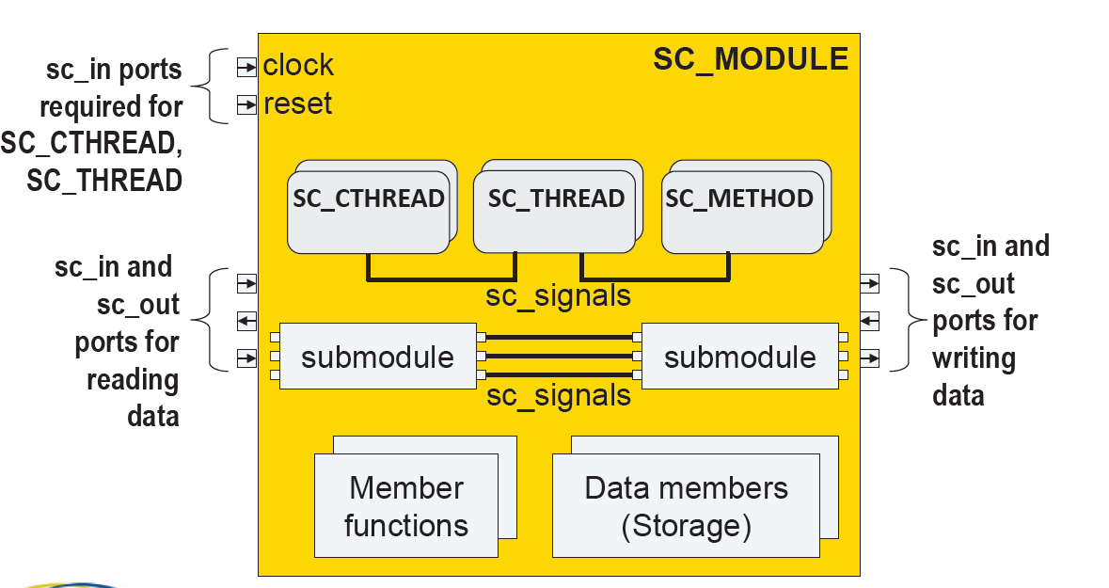
MatchLib Relationship to SystemC Standards
Accellera SystemC Synthesizeable Subset Standard focuses on what’s in diagram below
Modules, Ports, Processes, clocks, resets, signal IO, datatypes

Slide 8
Proposed SystemC HLS Standards Layers
Parameterized AXI4 Fabric Components
Banked Memories
Crossbar, Reorder Buffer, Cache
Parameterized NOC components
SystemC MatchLib IP Blocks Standard
SystemC Synthesizable Connections Standard
Throughput accurate modeling
Message latency and capacity back annotation
Random stall injection
Waveform generation
Transaction logging and debugging
Accurate and also fast TLM modes
SystemC Synthesizable Subset Standard
SystemC Language Standard

Slide 9
Matchlib Key Coding Guidelines: When do you need to use Non-blocking IO?
Arbitration requires Peek or PopNB to all arbitrated inputs.
Time-based splitting and merging of transaction streams requires PushNB and PopNB (respectively)
Even when using NB IO, it is best to have at least one blocking IO call in each iteration of a loop
This ensures Catapult understands a clear relationship between II of loop and IO behavior.
There are cases where a process will need ALL non-blocking IO (all PopNB and PushNB), but it should be pretty rare.
In this case the process should be kept as small / simple as possible, ideally communicating with other processes that follow the guidelines above.
With all non-blocking IO, you will likely be modeling at very close to RTL level, and most likely HLS will just be translating SC RTL into Verilog RTL.

Slide 10
Matchlib: Always prefer to use blocking IO over nonblocking IO.
Your models will be simpler and more likely to have a good process structure.
100% blocking IO is called KPN (Kahn Process Networks)
KPN is deterministic
easier to verify.
Non-blocking IO is sometimes needed, but introduces timing dependent behavior, and can make verification more difficult in some cases if the timing dependent behavior is externally visible.
Summary: always ask yourself if use of non-blocking IO is really justified.

Slide 11
Key Guidelines for Coding for Good QOR in SC
Simulate and debug your pre-HLS model before you synthesize (!)
Verify performance and functionality in your pre-HLS model
In SystemC HLS, you should always have:
At least a rough idea of what your HW implementation will be (e.g. pipeline characteristics)
An exact idea of what your module pin level interfaces are
Refine your architecture in your pre-HLS model
Usually this is by far the most effective way to improve QOR
If functionality can easily be split into smaller processes, it is usually better to do so
Control FSMs generated by Catapult will be smaller
Smaller processes may be able to run in parallel

Slide 12
Can I use “feature X” with Catapult SystemC Flow?
AC Datatypes – Yes
AC Math – Yes
AC DSP – Functions only, no hierarchy or instantiated AC channels
AC channel – No
“Interface synthesis” – Generally, No
“Interface synthesis for C arrays in single process” - Yes
Ccores – Yes
Blackboxes – Yes
Catapult Directives – Generally, Yes
Coupled_IO - Yes

Slide 13
Matchlib Accuracy
Goal of Matchlib is to be “thoughput accurate” in pre-HLS models, even as you scale up size of systems.
Goal is NOT to be precisely cycle accurate wrt RTL
Even with some differences in accuracy wrt RTL, there is big value in being able to model time/performance in the pre-HLS models.
It is useful to understand where sources of inaccuracies may arise and how to address them if desired.

Slide 14
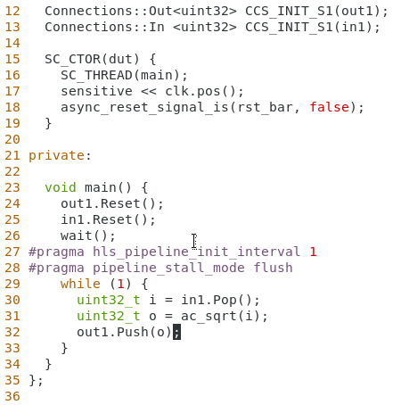
Small Example
Matchlib assumes all processes are pipelined with an II=1.
Matchlib assumes stall_mode=flush.
Matchlib assumes coupled_io=false.
Matchlib assumes pipeline latency = 1
Pre-HLS sim of model on right will Pop and Push one transaction on every clock.
Output will appear one clock after input.
Post-HLS RTL will have same behavior except latency will increase.
ac_sqrt likely to require several clock cycles latency in RTL.

Slide 15
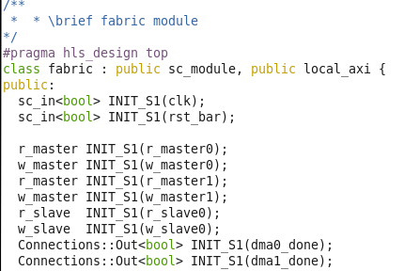
Larger Example: AXI4 Bus Fabric using MatchLib
AXI4 Fabric
Address Map
Top level of design.
DMA0
AXI4 Router/
Splitter
AXI4
Arbiter
RAM0
0x00000
0x7FFFF
CPU
AXI4 Router/
Splitter
AXI4 Router/
Splitter
AXI4
Arbiter
0x80000
DMA1
RAM1
0x8FFFF
Two DMA instances.
Two RAM instances.
Blue boxes are MatchLib
Components
This example is in the Catapult
Matchlib examples kit as
09_axi_fabric
= top level of design
DMA0 and DMA1
are two instances
of DMA shown earlier
Notes:
Larger Example: AXI4 Bus Fabric using MatchLib
Animations:
Top level of design
Two DMA Instances
Two RAM Instances

Slide 16
AXI4 Bus Fabric using MatchLib – Test #0
AXI4 Fabric
DMA0
AXI4 Router/
Splitter
AXI4
Arbiter
RAM0
AXI4 Router/
Splitter
RAM0 and RAM1
each have one read
and one write port
CPU
DMA1
AXI4 Router/
Splitter
AXI4
Arbiter
RAM1
Test #0: Concurrently,
DMA0 reads/writes 320 beats to RAM0
DMA1 reads/writes 320 beats to RAM1
(a beat is the data chunk transferred on the bus in 1 clock cycle)
Notes:
AXI4 Bus Fabric using MatchLib – Test #0
Animations:
DMA0 reads from RAM0 and DMA1 reads from RAM1
DMA0 writes to RAM0 and DMA1 writes to RAM1

Slide 17
AXI4 Bus Fabric Test #0 simulation logs
BEFORE HLS (SystemC simulation)
0 s top Stimulus started
6 ns top Running FABRIC_TEST # : 0
44 ns top.ram0 ram read addr: 000000000 len: 0ff
44 ns top.ram0 ram write addr: 000002000 len: 0ff
49 ns top.ram1 ram write addr: 000002000 len: 0ff
49 ns top.ram1 ram read addr: 000000000 len: 0ff
304 ns top.ram0 ram read addr: 000000800 len: 03f
309 ns top.ram1 ram read addr: 000000800 len: 03f
311 ns top.ram0 ram write addr: 000002800 len: 03f
316 ns top.ram1 ram write addr: 000002800 len: 03f
385 ns top dma_done detected. 1 1
385 ns top start_time: 46 ns end_time: 385 ns
385 ns top axi beats (dec): 320
385 ns top elapsed time: 339 ns
385 ns top beat rate: 1059 ps
385 ns top clock period: 1 ns
425 ns top finished checking memory contents
AFTER HLS (Verilog RTL simulation)
# 0 s top Stimulus started
# 6 ns top Running FABRIC_TEST # : 0
# 55 ns top/ram0 ram write addr: 000002000 len: 0ff
# 60 ns top/ram1 ram write addr: 000002000 len: 0ff
# 68 ns top/ram0 ram read addr: 000000000 len: 0ff
# 70 ns top/ram1 ram read addr: 000000000 len: 0ff
# 340 ns top/ram0 ram write addr: 000002800 len: 03f
# 342 ns top/ram1 ram write addr: 000002800 len: 03f
# 343 ns top/ram0 ram read addr: 000000800 len: 03f
# 345 ns top/ram1 ram read addr: 000000800 len: 03f
# 414 ns top dma_done detected. 1 1
# 414 ns top start_time: 55 ns end_time: 414 ns
# 414 ns top axi beats (dec): 320
# 414 ns top elapsed time: 359 ns
# 414 ns top beat rate: 1122 ps
# 414 ns top clock period: 1 ns
# 454 ns top finished checking memory contents
Before and after HLS we get nearly one beat per clock cycle
Notes:
AXI4 Bus Fabric Test #0 simulation logs
Animations:
1. Before and after HLS we get nearly one beat per clock cycle

Slide 18
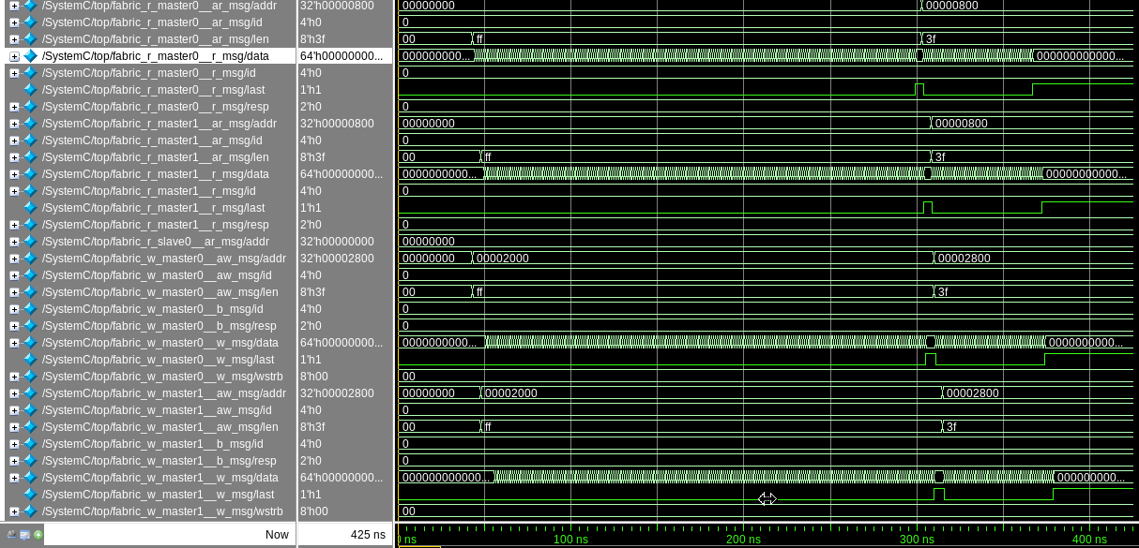
AXI4 Fabric Waveforms Before Catapult HLS–Test #0 (SystemC)
Master0
Read Data
Master1
Read Data
Master0
Write Data
Master1
Write Data
Notes:
AXI4 Fabric Waveforms Before Catapult HLS–Test #0 (SystemC)
We see AXI4 concurrent read and write transfers are making optimal utilization of AXI4 bus.

Slide 19
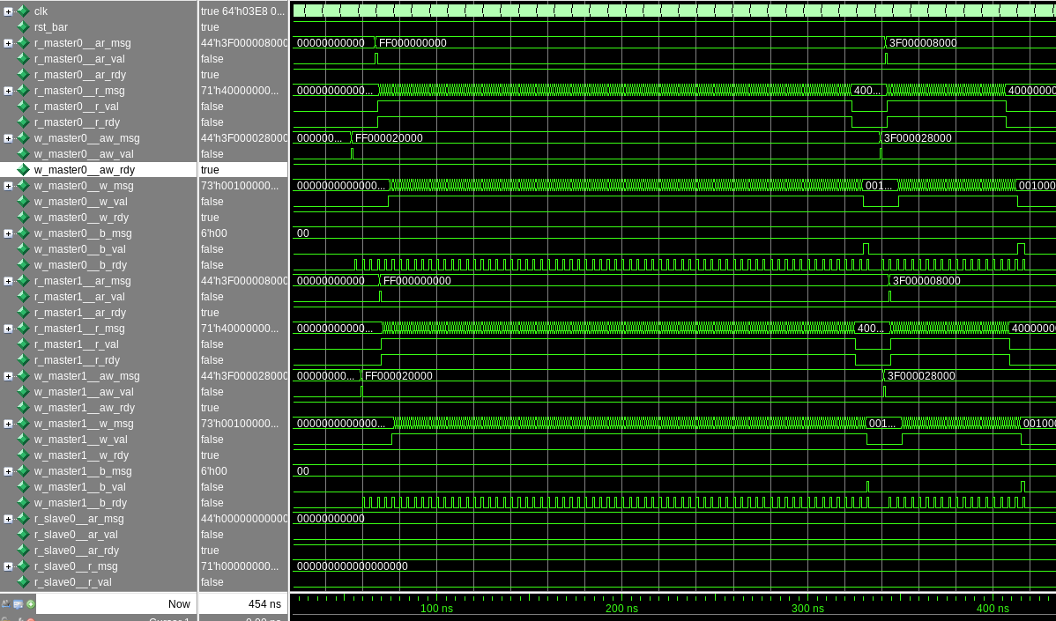
AXI4 Fabric Waveforms After Catapult HLS – Test #0 (Verilog)
Master0
Read Data
Master0
Write Data
Master1
Read Data
Master1
Write Data
Thoughput in RTL Matches SystemC
Notes:
AXI4 Fabric Waveforms After Catapult HLS – Test #0 (Verilog)
Animations:
Throughput in RTL Matches SystemC

Slide 20
AXI4 Bus Fabric using MatchLib – Test #1
AXI4 Fabric
DMA0
AXI4 Router/
Splitter
AXI4
Arbiter
RAM0
AXI4 Router/
Splitter
RAM0 and RAM1
each have one read
and one write port
CPU
DMA1
AXI4 Router/
Splitter
AXI4
Arbiter
RAM1
Test #1: Concurrently,
DMA0 reads/writes 320 beats to RAM0
DMA1 reads 320 beats from RAM1 and writes to RAM0
Note contention on RAM0 writes
Notes:
AXI4 Bus Fabric using MatchLib – Test #1
Animations:
DMA0 reads from RAM0 and DMA1 reads from RAM1
DMA0 writes to RAM0 and DMA1 writes to RAM0

Slide 21
AXI4 Bus Fabric Test #1 simulation logs
BEFORE HLS (SystemC simulation)
0 s top Stimulus started
6 ns top Running FABRIC_TEST # : 1
44 ns top.ram0 ram read addr: 000000000 len: 0ff
44 ns top.ram0 ram write addr: 000002000 len: 0ff
49 ns top.ram1 ram read addr: 000000000 len: 0ff
304 ns top.ram0 ram read addr: 000000800 len: 03f
308 ns top.ram0 ram write addr: 000006000 len: 0ff
560 ns top.ram1 ram read addr: 000000800 len: 03f
566 ns top.ram0 ram write addr: 000002800 len: 03f
632 ns top.ram0 ram write addr: 000006800 len: 03f
701 ns top dma_done detected. 1 1
701 ns top start_time: 46 ns end_time: 701 ns
701 ns top axi beats (dec): 320
701 ns top elapsed time: 655 ns
701 ns top beat rate: 2047 ps
701 ns top clock period: 1 ns
741 ns top finished checking memory contents
AFTER HLS (Verilog RTL simulation)
# 0 s top Stimulus started
# 6 ns top Running FABRIC_TEST # : 1
# 55 ns top/ram0 ram write addr: 000002000 len: 0ff
# 68 ns top/ram0 ram read addr: 000000000 len: 0ff
# 70 ns top/ram1 ram read addr: 000000000 len: 0ff
# 335 ns top/ram0 ram write addr: 000006000 len: 0ff
# 343 ns top/ram0 ram read addr: 000000800 len: 03f
# 598 ns top/ram1 ram read addr: 000000800 len: 03f
# 598 ns top/ram0 ram write addr: 000002800 len: 03f
# 670 ns top/ram0 ram write addr: 000006800 len: 03f
# 736 ns top dma_done detected. 1 1
# 736 ns top start_time: 55 ns end_time: 736 ns
# 736 ns top axi beats (dec): 320
# 736 ns top elapsed time: 681 ns
# 736 ns top beat rate: 2128 ps
# 736 ns top clock period: 1 ns
# 776 ns top finished checking memory contents
Two concurrent writes to RAM0 cause beat rate to be above two clock cycles.
Notes:
AXI4 Bus Fabric Test #1 simulation logs
Animations:
1. Two concurrent writes to RAM0 cause beat rate to be above two clock cycles.

Slide 22
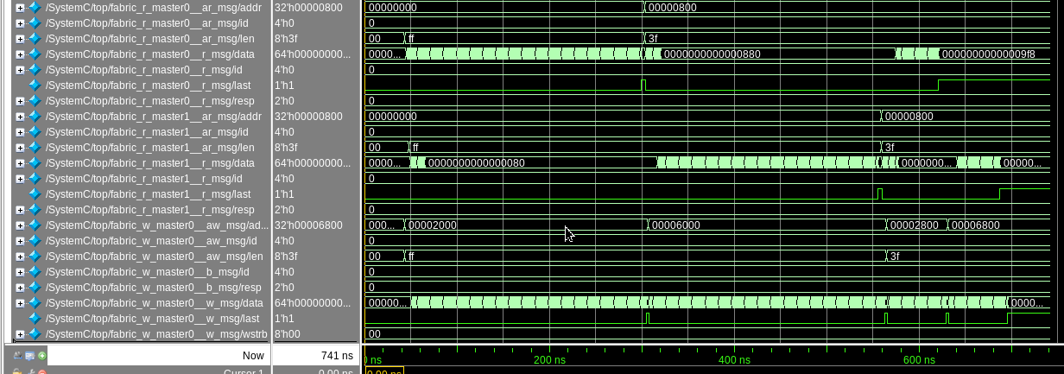
AXI4 Fabric Waveforms Before Catapult HLS –Test#1 (SystemC)
Master0
Read Data
Master1
Read Data
Master0
Write Data
256 beats from r_master0
256 beats from r_master1
64 beats
from
r_master0
64 beats
from
r_master1
w_master0 fully utilized over 700 ns due to write contention
r_master0 and r_master1 underutilized due to write contention
Notes:
AXI4 Fabric Waveforms Before Catapult HLS –Test#1 (SystemC)
Animations:
w_master0 fully utilized over 700 ns due to write contention
r_master0 and r_master1 underutilized due to write contention

Slide 23
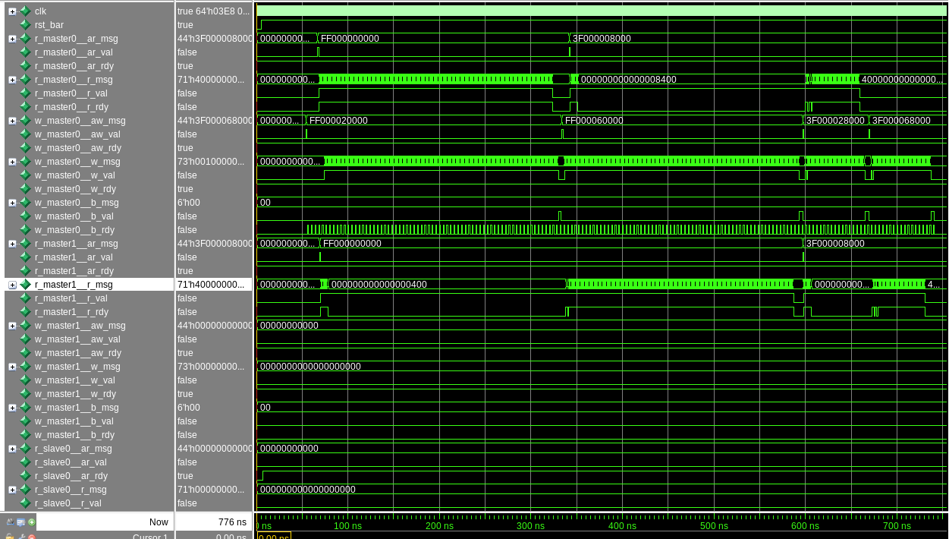
AXI4 Fabric Waveforms After Catapult HLS – Test #1 (Verilog)
Master0
Read Data
Master0
Write Data
Master1
Read Data
Throughput in RTL Matches SystemC
Notes:
AXI4 Fabric Waveforms After Catapult HLS – Test #1 (Verilog)
Animations:
Throughput in RTL matches SystemC

Slide 24
Key Observations
“Throughput accuracy” of Matchlib pre-HLS models is generally retained even as you scale up size of systems.
Ability to view, analyze, and debug time-based behaviors and waveforms in pre-HLS models is very valuable to:
HW architects
HLS engineers
DV engineers
RTL designers on project who will “never touch” HLS or C++/SC models.

Slide 25
Matchlib “throughput accuracy” is high for:
Feedforward data streams
Feedback data streams
Systems with multiple clocks and multiple data stream rates
Divergent data streams
Arbitration of data streams (for any reasonably fair arbitration scheme)
e.g. round robin

Slide 26
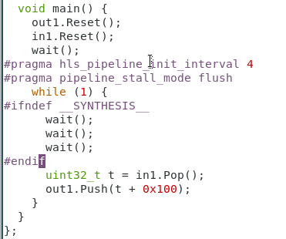
Design aspects which require extra handling:
If II != 1, then need to manually insert waits into pre-HLS model to account for this.
Currently memory accesses for both internal and external memories are not accounted for in Matchlib timing
In other words, Matchlib currently assumes that low level memory accesses themselves are not primary bottlenecks.
If they are, then that should be explicitly modeled using Push/Pop or wait() statements.
This may be improved in a future release.
As mentioned earlier, if you use PushNB/PopNB in your DUT or TB, you may introduce timing dependent behavior that can cause pre-HLS vs post-HLS mismatches.
But PushNB/PopNB do not introduce timing inaccuracies per se.

Slide 27
How Catapult changes latency and capacity of design…
When Catapult synthesizes processes/blocks it typically adds latency
In other words, post-HLS model will usually have higher latency than pre-HLS model.
If loop pipelining is used, then it typically also adds capacity.
In effect, the HW pipeline is like a HW fifo with the functionality “folded in”.
The HW pipeline acts very much like a HW fifo, especially if stall_mode=flush.
If coupled_io_mode=true is used, then this removes a small amount of capacity and elasticity as compared to pre-HLS model.
Matchlib supports a “latency and capacity” back-annotation feature to easily back-annotate post-HLS values back into pre-HLS model.
This increases accuracy significantly of the pre-HLS sim versus the post-HLS sim.
However, you should still not expect exact matches in timing behavior.

Slide 28
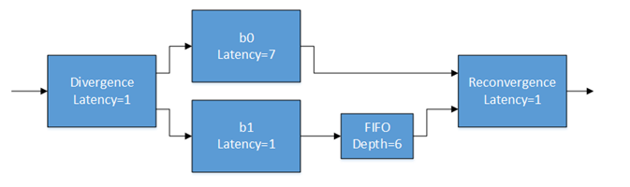

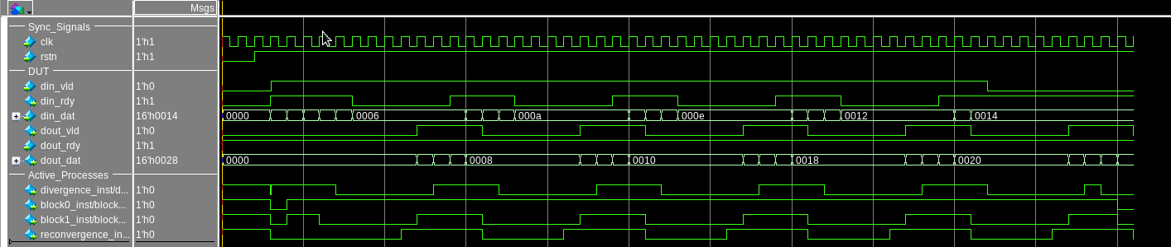
Stuttering Design Example (72* : bagel shop example)
II=1 for all blocks
Latency of b0 is 1 pre-HLS (by default)
Latency of b0 is 7 post-HLS
Post-HLS waveforms below show stuttering due to reconverging data streams with unbalanced latencies and capacities.

Slide 29
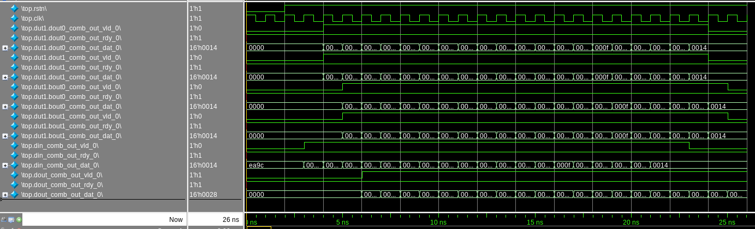
Stuttering Design Example Pre-HLS Default Waveforms
Latency of b0 is 1 pre-HLS (by default)
Default pre-HLS waveforms below show no stuttering – new output is seen on every clock.

Slide 30
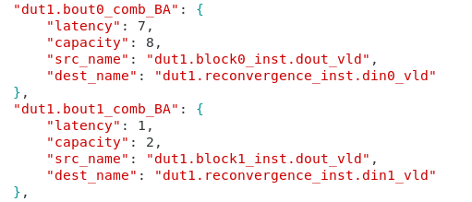
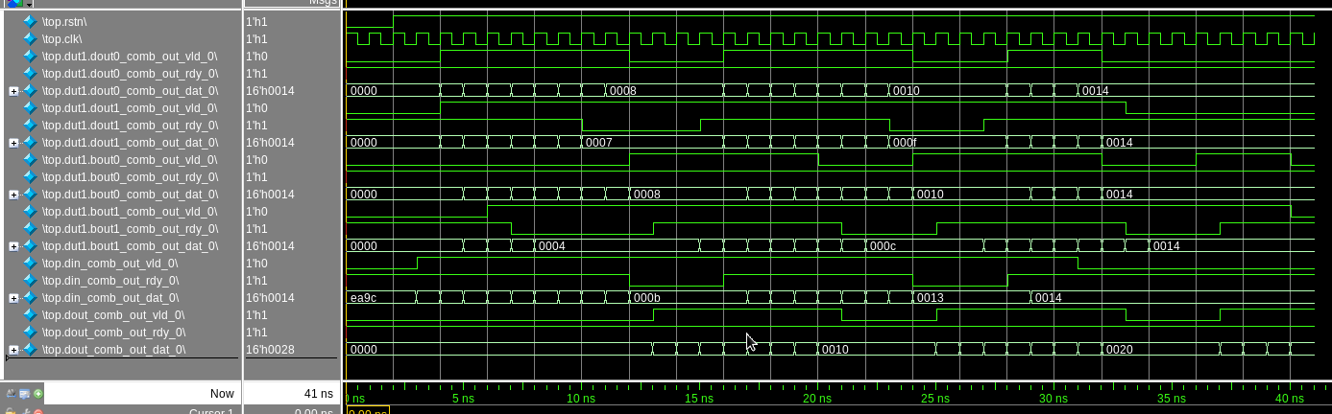
Stuttering Design Example Pre-HLS with back-annotation
Now we back-annotate latency and capacity of b0 and b1
Pre-HLS waveforms below now show stuttering

Slide 31
Areas where Matchlib “throughput accuracy” is harder
Stuttering due to re-convergent data streams (the example just shown)
Back annotation can fairly easily show existence of issue and point to the solution
Achieving exact match with timing behavior of post-HLS model is harder because:
Overall thruput is highly dependent on local latencies and capacities in various blocks
Even small things like coupled_io=true or stall_mode=stall can have a big impact on stuttering in RTL
Thorough validation that system has no deadlock behaviors
Matchlib is useful in finding and resolving many deadlock scenarios in pre-HLS model
However, some deadlock scenarios are highly dependent on detailed cycle level behavior and RTL latencies/capacities, and must be verified in the RTL.
A useful strategy for both of the above scenarios is to “sweep” the latency/capacity values in the pre-HLS back-annotation to stress test the model
This will increase the chances that the RTL has no bugs
It will also be much easier to debug any issues that are found (as compared to debugging in RTL).

Slide 32
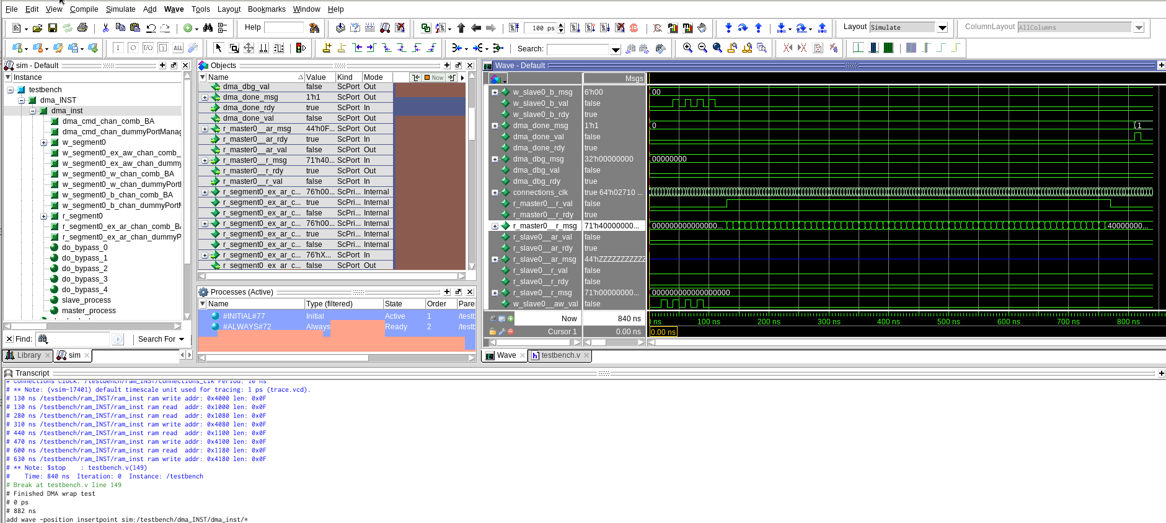
Pre-HLS Debugging in Questa, VCS, Xcelium
HW – aware debugging in pre-HLS model, can support mixed language (e.g. SV UVM TB + SC DUT)

Slide 33
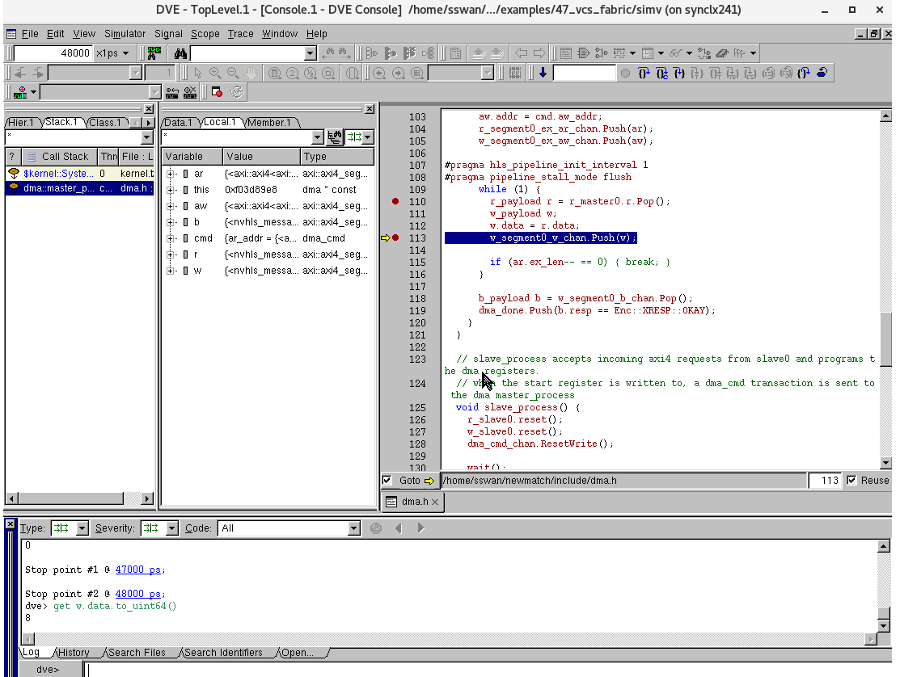
Pre-HLS Debugging in Questa, VCS, Xcelium
Key advantage: HW aware debugging and throughput accurate modeling with quick edit/debug turnaround..

Slide 34
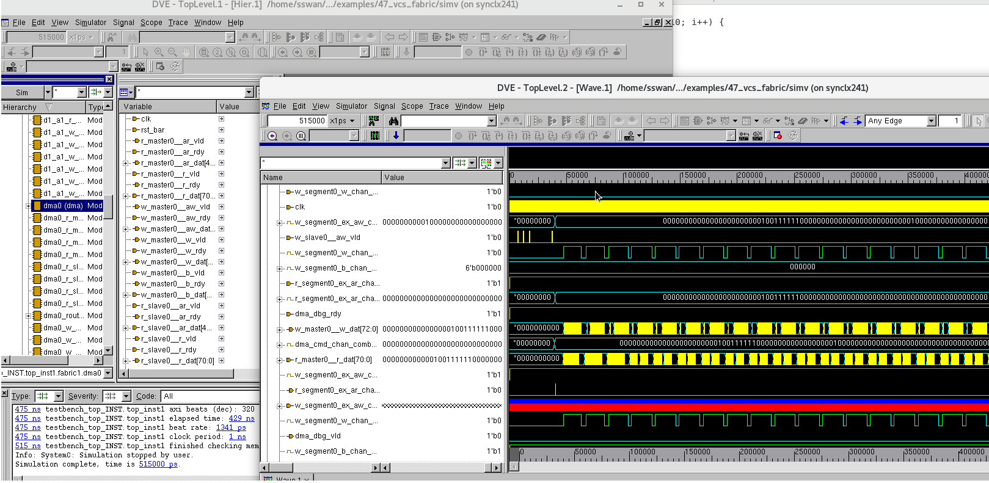
Pre-HLS Debugging in Questa, VCS, Xcelium (cont)

Slide 35
Supporting Custom Protocols in Catapult SystemC & Matchlib
First question: Do you really need a new custom protocol?
Most modern on-chip bus protocols use message passing (e.g. AXI3/4, NOC protocols, etc).
Message passing means "ready/valid/data" signaling.
Message passing protocols are easily layered on top of Matchlib Connections
Existing AXI4 transactors are built using this approach:
See: $MGC_HOME/shared/examples/matchlib/toolkit/doc/matchlib_customer_training.ppt
Second Question: Is it a very simple signal level protocol?
Very simple signal level protocols can be easily built by combining Connections::In/Out with sc_signals
See $MGC_HOME/shared/examples/matchlib/toolkit/examples/13_toggle_protocol

Slide 36
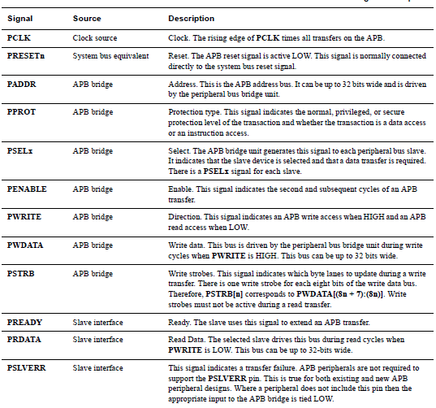
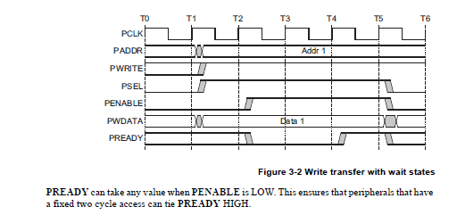
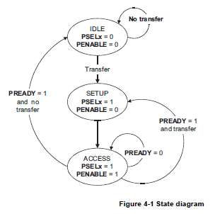
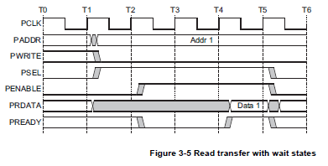
Non-Trivial Custom Protocol Example: ARM APB (52_apb)
Step 1: Study the protocol spec (structural interface and state descriptions)
See: https://developer.arm.com/documentation/ihi0024/c
Note: FSM perspective is
bus, not master or slave.
So it is a bit misleading..

Slide 37
Non-Trivial Custom Protocol Example: Step 2
Abstract the protocol up to the message passing level.
Goal: User’s HLS model uses message passing interfaces only (Connections::In/Out).
All timing details and signal handshakes are hidden inside transactor.
We need to define transaction types and the number of message passing interfaces that user’s model will see.
To get good QOR and be as flexible as possible, the strategy is to keep the message passing interfaces "as close to the HW protocol" as possible while still abstracting away timing behaviors.
User’s HLS model will almost always use blocking message passing calls exclusively.
Protocol transactor will almost always use non-blocking message passing calls exclusively.
It does this while simultaneously managing the signal level protocol and detailed timing.
Note: Catapult does not support Stratus "protocol regions", and we do not need it to support them.
What we do instead is push the "protocol region" into its own thread (in the transactor) and use message passing to communicate with it.

Slide 38
Non-Trivial Custom Protocol Example: Step 2 (cont.)
For protocols such as AHB which support pipelined behaviors and bursts, it is important to consider how to design the interfaces and transactors to support full throughput.
Message passing interfaces make this easier to achieve since they are easily pipelined.
APB is a simple protocol with no bursts and no simultaneous reads and writes.
We can simply have a single "req" channel which contains the request, and a single "rsp" channel which contains the response.
These two channels are shared between reads and writes because the APB wires for reads and writes are also shared.
For a HW protocol which had fully separate wires for reads and writes we would want fully separate wr_req/wr_rsp and rd_req/rd_rsp channels.

Slide 39
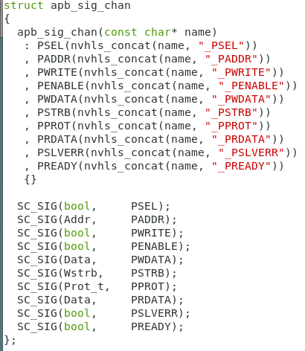
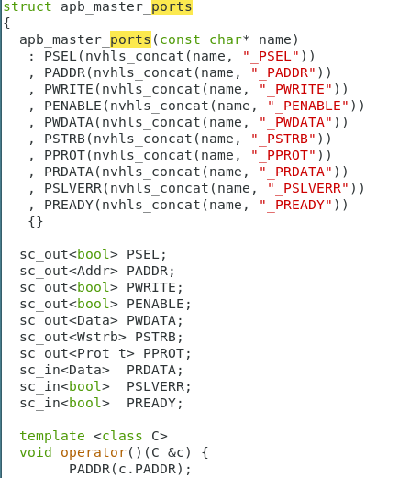
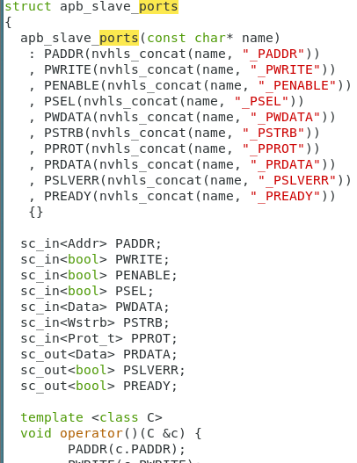
Non-Trivial Custom Protocol Example: Step 3
Create classes to represent APB channels and ports

Slide 40
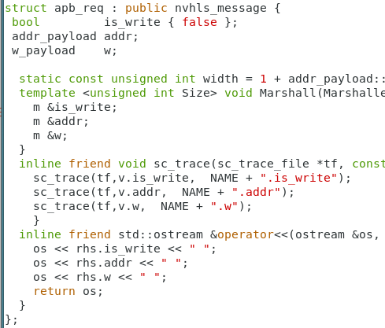
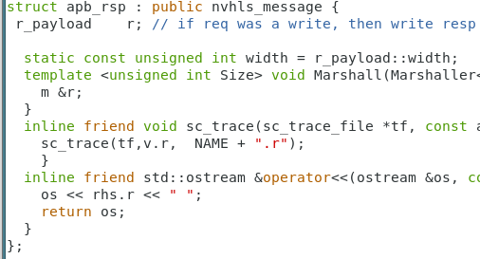
Non-Trivial Custom Protocol Example: Step 4
Define transaction message classes

Slide 41
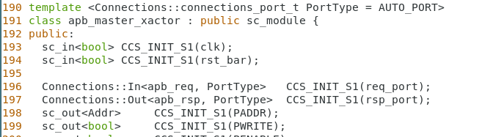
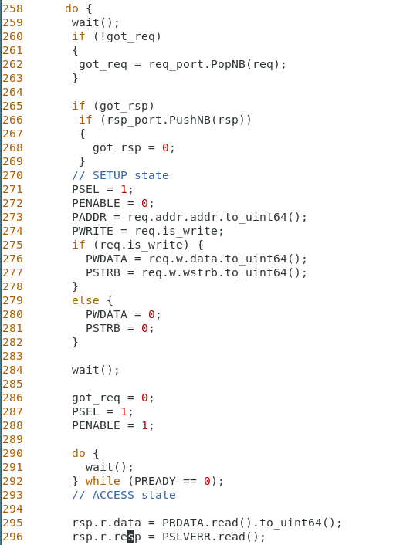
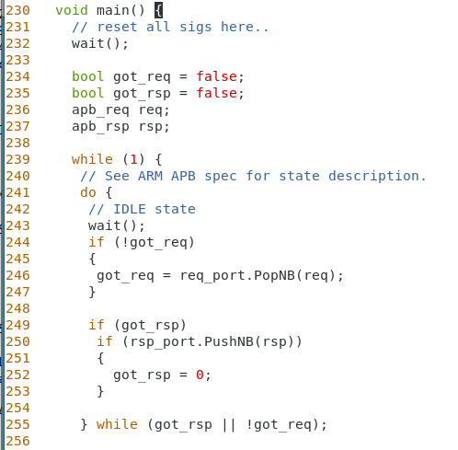
Non-Trivial Custom Protocol Example: Step 5
Create the protocol transactor code
Strategy: Use PopNB/PushNB to set “got_req” and “got_rsp” flags while simultaneously managing the signal level protocol.

Slide 42
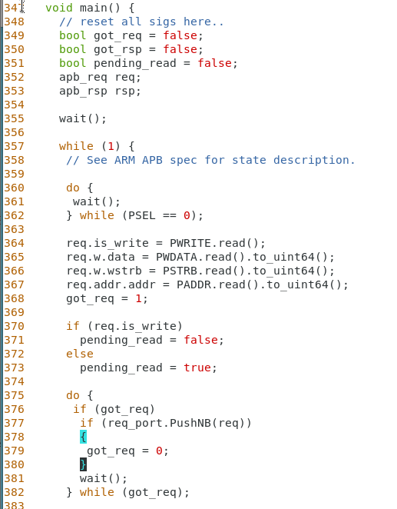
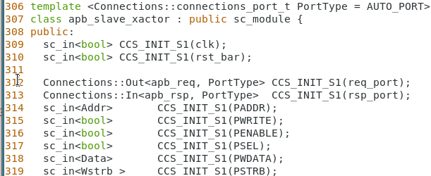
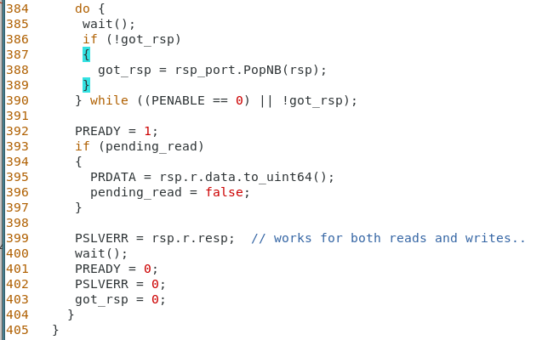
Non-Trivial Custom Protocol Example: Step 5 (cont.)
Create the protocol transactor code (apb_slave_transactor here)

Slide 43
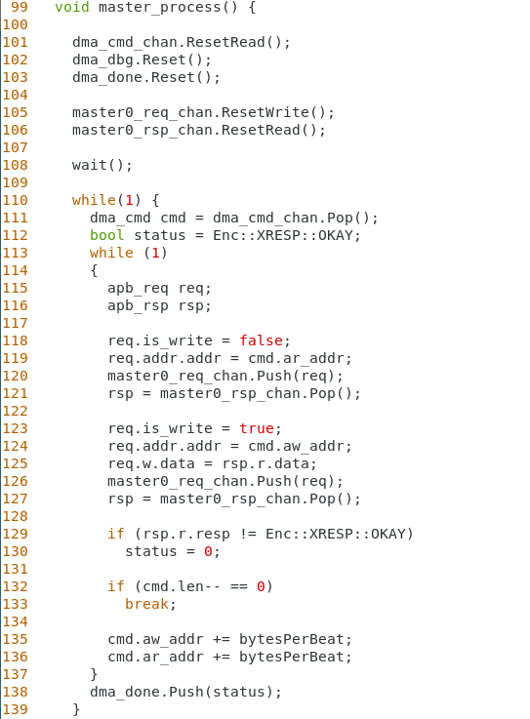
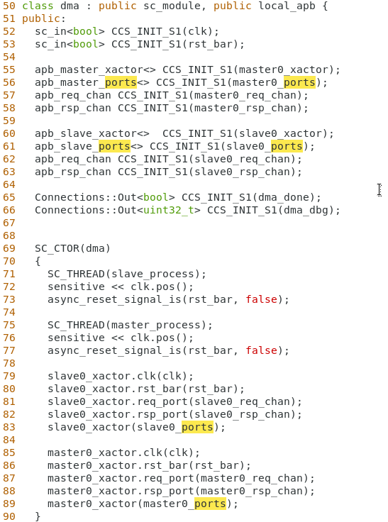
Non-Trivial Custom Protocol Example: Step 6
Instantiate transactor in user’s HLS model

Slide 44
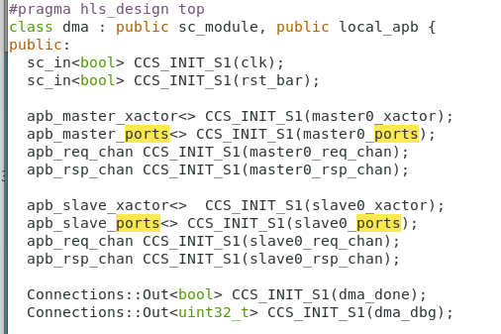
52_apb Design Example
clk
CPU Stimulus
clk
DMA
clk
RAM
rst
rst
rst
apb_master_ports
apb_slave_ports
apb_master_ports
apb_slave_ports
Control Regs
dma_done
dma_done
= top level of design

Slide 45
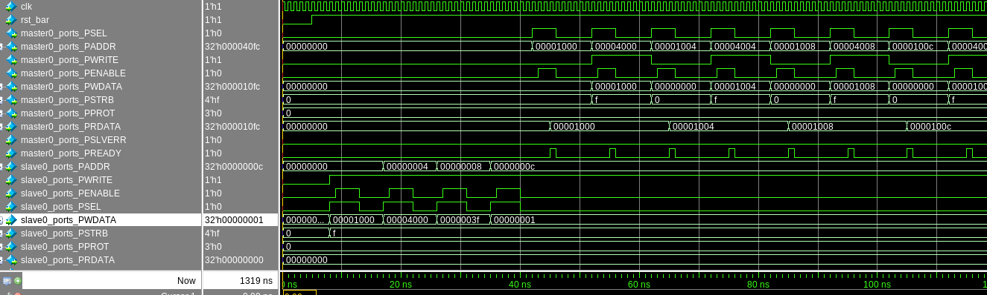
Running 52_apb Example RTL
Note clean preservation of all APB signal names in the Catapult generated Verilog RTL.

Slide 46
Custom Protocol Concluding Thoughts
If you are more comfortable writing Verilog RTL than SystemC, one approach is to write transactors in Verilog RTL first and then just translate to SC Matchlib afterwards.
After all, we are really just writing RTL in the transactors.
Applying the presented guidelines to a future ARM AHB transactor:
Will look very similar to APB transactor
Each req/rsp represents a single AHB beat (principle: stay close to the HW protocol. Need to support AHB bursts.)
Detailed AHB cycle level behavior is hidden from HLS model.

Slide 47
Shared Memories in SystemC Designs – Approach #1
Definition: A shared memory is an array in HLS that is preserved thru HLS that is accessed by more than one thread.
Approach #1: “Make the shared memory go away”
This approach is what many Matchlib users do in practice.
Use only preserved arrays which are accessed by a single thread
Use architectural directives in Catapult to allocate ports for those rams, etc.
Use Matchlib components such as Scratchpad, ArbitratedScratchpad, etc., to route requests from other threads to those arrays.
If throughput is top concern, and a few extra cycles of latency is OK, this is a very robust and flexible approach.
Pre-HLS sim will be throughput accurate under assumption that mem rd wr access to arrays within threads are not the bottleneck

Slide 48
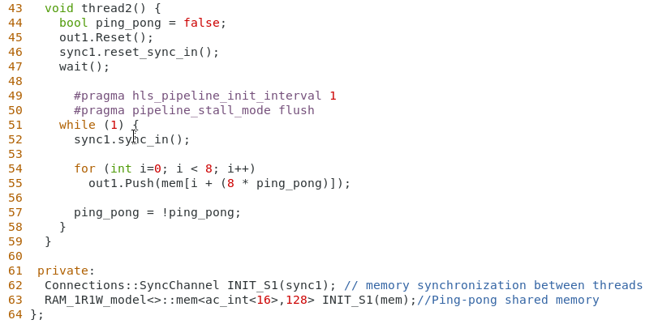
Shared Memories in SystemC Designs – Approach #2
Approach #2: Use memory model from Catapult Memory Generator
This is demonstrated in 12_ping_pong_mem
Each thread accessing memory needs a dedicated RAM port
There needs to be some synchronization scheme to avoid data races between threads
12_ping_pong_mem uses Connections::SyncChannel
Catapult memory generator SC models currently need “wait(0.3, SC_NS)” statements deleted from them so they work properly in Matchlib sims
Catapult memory generator SC models currently do not participate in Matchlib “thruput accurate” simulation mechanism, so sim will not be thruput accurate if thread has > 1 mem accesses per clock
Memory read operation
Memory instance

Slide 49
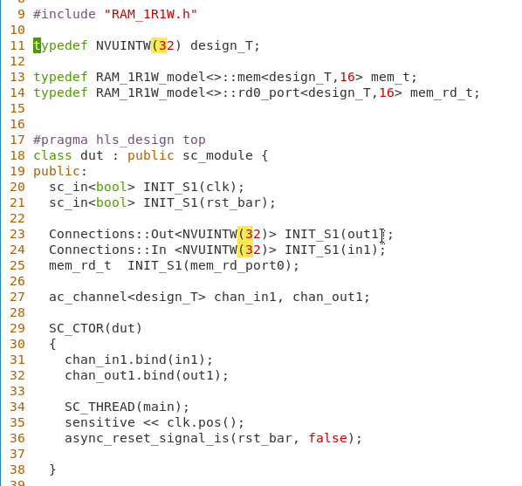
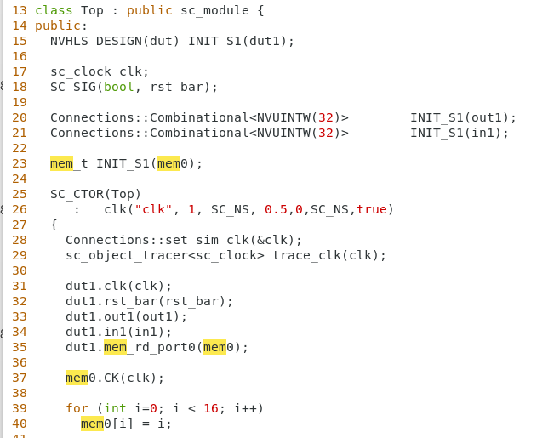
Shared Memories in SystemC Designs – Approach #2 (cont.)
Example 12_ping_pong_mem shows shared memory shared by threads in same module.
In this case, you do not need to explicitly code the mem read and write ports
You can also have memory ports on modules, so that memories can be external and/or shared between multiple modules.
In this case, you do need to explicitly code the mem read and write ports on module interfaces
Memory types
Memory read port
Bind memory read port to memory instance

Slide 50
Catapult SystemC Support for BIST Ports on RAMs
Current Status - three cases to consider:
RAM is internal to a process and is inferred based on usage of [] operator etc.
RAM is external to process and explicitly instantiated by user, but is instantiated with the SC hierarchy and the instantiation is netlisted into the RTL by Catapult.
RAM is instantiated by the user in RTL that is completely external to the RTL that is generated by Catapult.
If the user today is using the SC flow and wants BIST support, then we can only state that we natively support case #3 today. (Cases 1 and 2 would require that BIST pins be bubbled up in the generated RTL, and in the SC flow we cannot yet do that).
Alternative Approaches:
Handle BIST port insertion as an RTL post-processing step.
- Tessent and similar tools can do this automatically.
- Customers may have in house scripts/tools to do this automatically.
Enhance Catapult to insert BIST ports up the hierarchy (with an #ifdef) similar to way handled in C++ flow.

Slide 51
External Catapult SystemC / Matchlib Resources
Catapult SystemC MatchLib On-Demand Training (ODT)
https://eda.learn.sw.siemens.com/training/courses/catapult-high-level-synthesis-library
2021 Catapult Virtual Seminar (ML Accelerator using Matchlib):
https://event.on24.com/wcc/r/3187802/BF0CAE586A768CDB1314C956F64ABA35
Catapult Matchlib Webinars:
https://webinars.sw.siemens.com/how-matchlib-and-systemc-enables
https://webinars.sw.siemens.com/nvidia-design-and-verification-of-a-1
https://webinars.sw.siemens.com/early-axi-soc-performance
Youtube video from NVidia:
https://www.youtube.com/watch?v=n8_G-CaSSPU
Accellera SystemC Evolution Day 2020 Matchlib Presentation and Open Source Example Kit:
https://forums.accellera.org/files/category/2-systemc/

Slide 52
Thank you!

